Slide 2

Heart Hacker: Digital Stethoscope
How this idea came to be:
My experience as a cardiac/heart failure nurse
Inspiration from the possibilities that Python technology is capable of

Slide 3

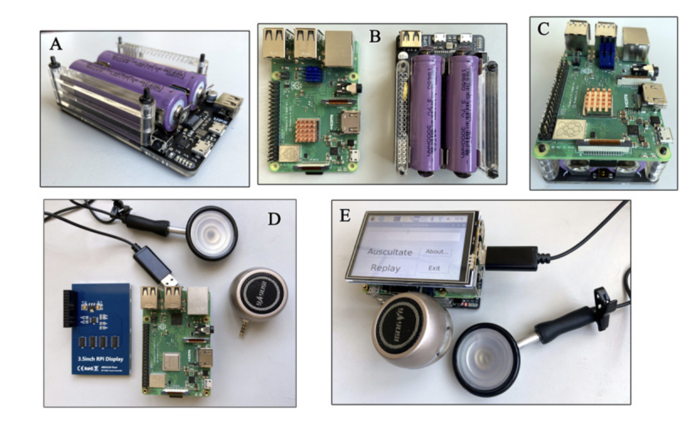
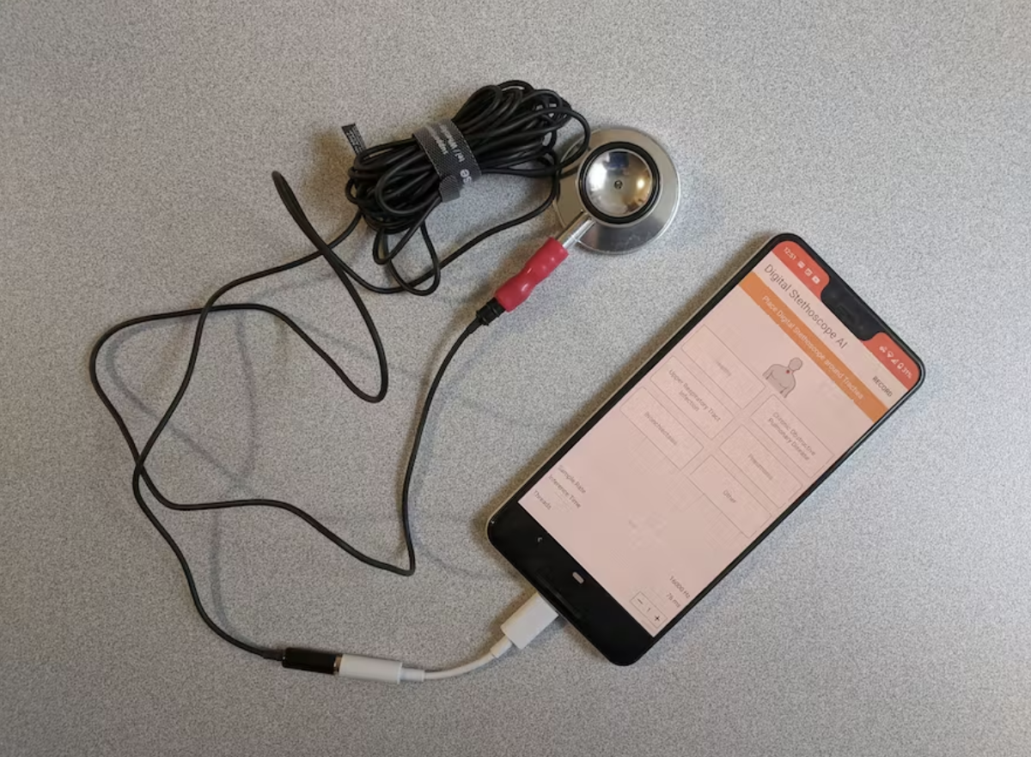
Source Code
AusculPi
https://github.com/YangChuan80/AusculPi-Console
Digital Stethoscope AI
https://github.com/Nyceane/Digital-Stethoscope-AI.git

Slide 4

Project Development
Sprint 1
Hardware
Creation of the record function

Slide 5
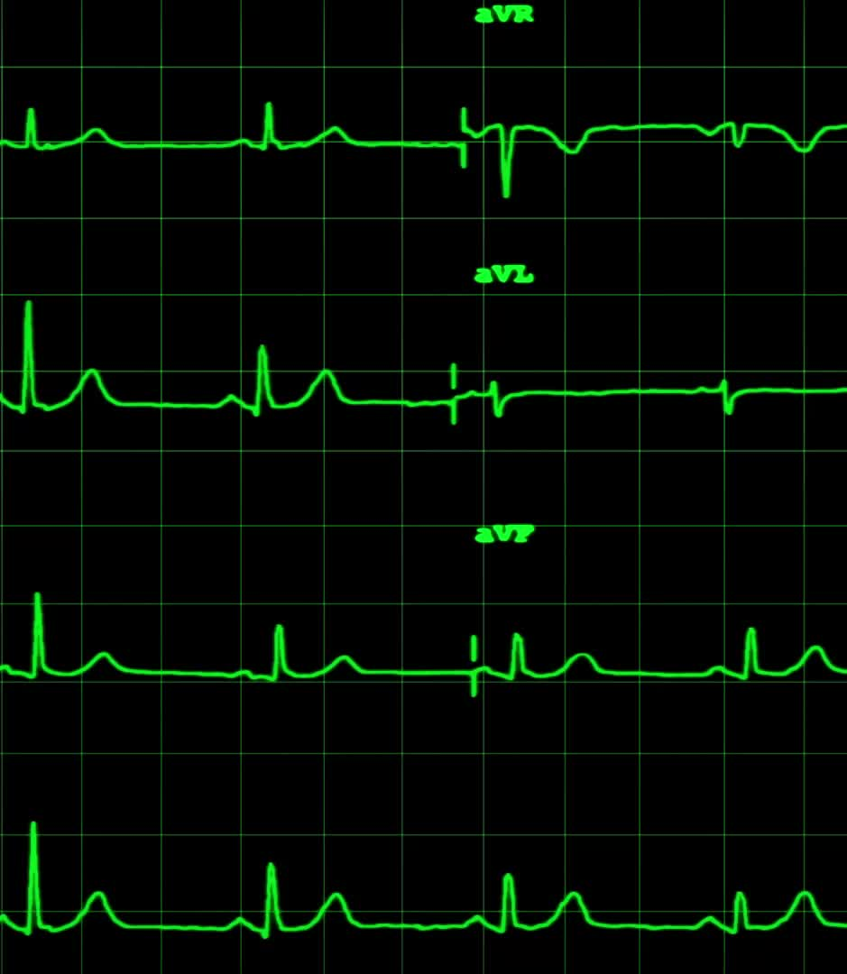
Sprint 2
Still determining the best hardware for this project
Created a heart detection function
Created a visualization of the results
Created a GUI that contains a record button
Added the visualization to the GUI

Slide 6
Sprint 3
Refined the audio quality and sensitivity: Fuzzy Function
Added a restart button to the GUI
Added graphics
Developed Tag Line & Splash Screen

Slide 7

Roadblocks
Hardware
Audio Sensitivity

Slide 8

Discoveries
The human ear’s ability to filter out background noise

Slide 9
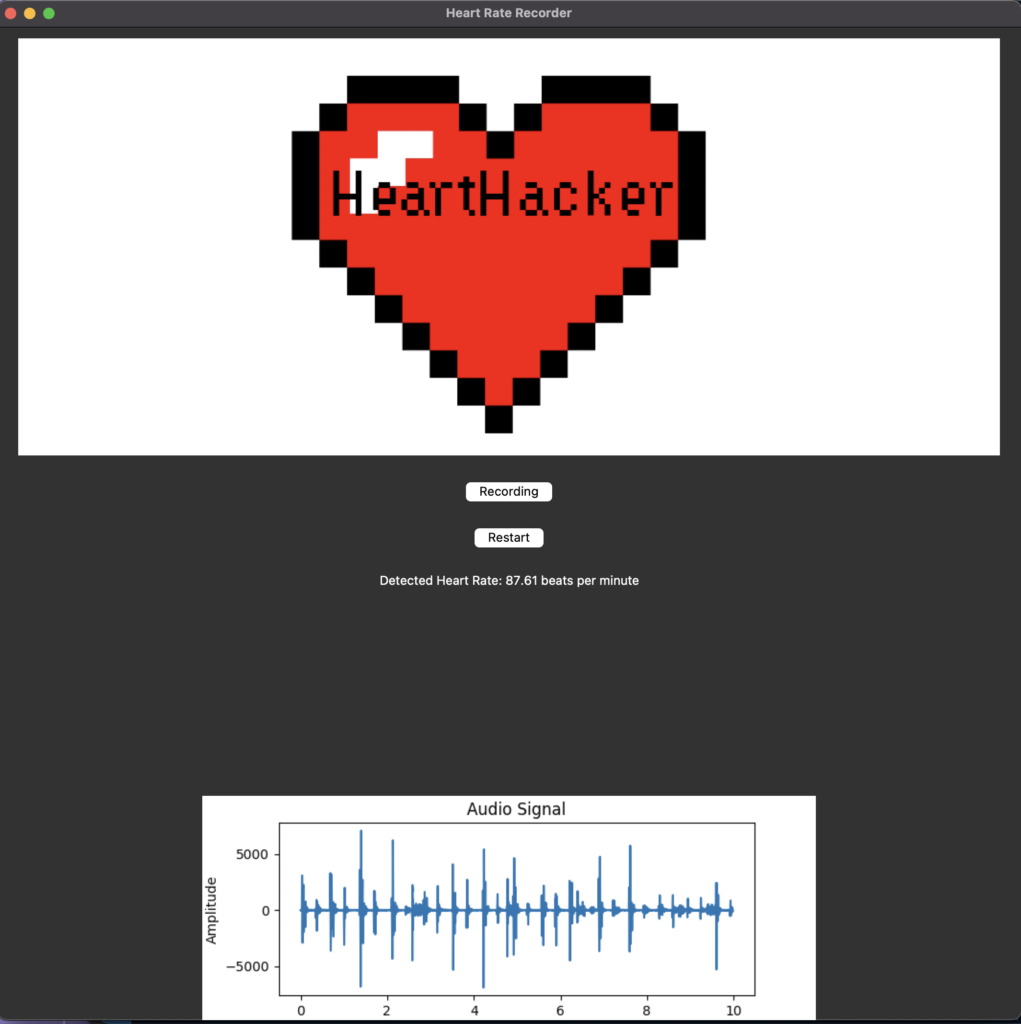
Demonstration

Slide 10

The Future
Arrythmia detection
Recognition of S1/S2/S3
Heart Murmur Recognition
Raspberry Pi

